Slide 1
ROC and AUC as a performance metric

Slide 2
Threshold
you can move your threshold up or down based on the requirement.
If we’re doing a disease prediction, we have to be very sure when we predict that the person doesn’t have a disease.
If we’re trying to predict a spam email , we have to be very confident when we predict that the email is spam..

Slide 3
Threshold
True label (Y) | Logit [sig(w.x + c)] | threshold | prediction
1 | 0.9 | 0.5 | 1
1 | 0.82 | 0.5 | 1
0 | 0.6 | 0.5 | 1
1 | 0.75 | 0.5 | 1
TN = 0 | FP = 1
FN = 0 | TP = 3

Slide 4
One more Example on Threshold
True label (Y) | Logit [sig(w.x + c)] | threshold | prediction
1 | 0.9 | 0.7 | 1
1 | 0.82 | 0.7 | 1
0 | 0.6 | 0.7 | 0
1 | 0.75 | 0.7 | 1
TN = 1 | FP = 0
FN = 0 | TP = 3
Threshold of 0.61 would also give us the same results

Slide 5
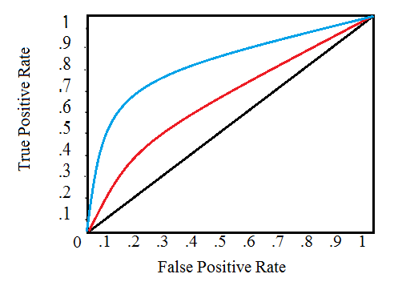
Receiver Operator Characteristic
ROC provides a simple way to summarize all the information .
Y - True positive rate
X - False positive rate

Slide 6
Steps for calculating ROC
Start from a very low threshold i.e.., 0.01
Compute predictions and calculate the confusion matrix
Calculate ‘True positive rate’ , and ‘False positive rate’
Iterate by increasing threshold by 0.01 till we reach the maximum threshold 0.99
Connect all the dots to a get a graph, This is called an ROC graph
The threshold with Highest True positive rate and Least False positive rate is the threshold we need to set for our model

Slide 7
Area under the curve
Total area the “ROC” graph has covered
Comparison metric to select best model out of all models trained
Suppose we have trained two logistic regression models with different hyper parameters and we are confused to select the best one out of both .
plot the “ROC” for two models and calculate the “AUC” of each graph .
select the model that has higher “AUC”

